Slide 1
Skin Cancer Analysis

Slide 2
Null Hypothesis (H0)
There is no relationship between the sex of the patient and the age at which they are diagnosed with skin cancer

Slide 3
Alternate Hypothesis (H1)
There is a relationship between the sex of a patient and the age at which they are diagnosed with skin cancer.
Females are more likely to be diagnosed with skin cancer at an earlier age than males.

Slide 4
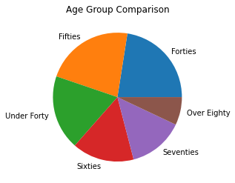
Graphs

Slide 5
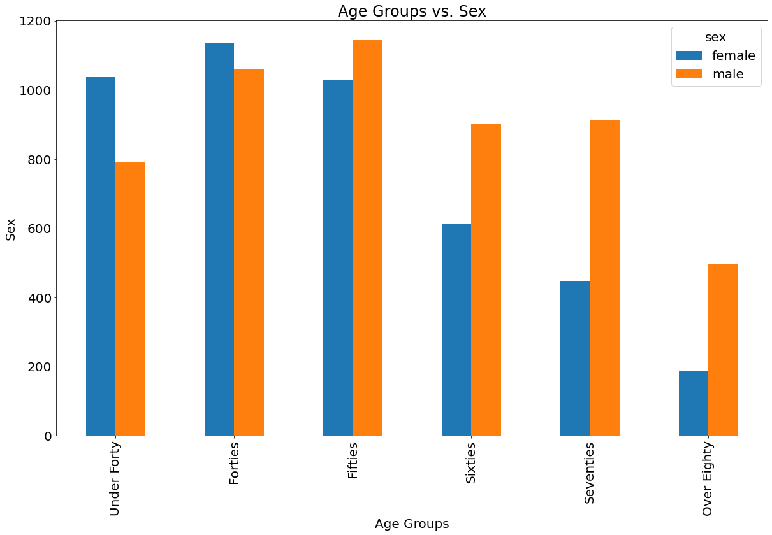
Graphs cont.

Slide 6
Results Described
The graph of Age vs. Sex shows a decrease in counts as age increases.
Other than the younger groups of under forty and forties females seem to have a higher count than males.

Slide 7
Statistical Analyses (Tests Done)
ANOVA
T-test

Slide 8
Our H0 was…

Slide 9
Therefore, our H1 was…

Slide 10
Conclusion

Slide 11
Discussion

Slide 12
References

